Slide 1
Computer Science A-level coursework
Ben Curtis

Slide 2
Project explanation
A booking management system with network access and separate client/owner environments

Slide 3
SQL reading/writing library
Creating a custom library to be used on the central server that contains all the necessary code to read from and write to an sql database to keep my final project neater with less code repetition.

Slide 4
Necessary sql functions
Append a new value/record to the database as a tuple to prevent sql injection
Replace/overwrite entries when given the new value and the one to be replaced
Read and return a set of records as a 2d array when given the sql code to be executed
Read and write encrypted entries for password security using asymmetrical encryption where a single server has access to the private key

Slide 5
Sequence of events in logins
User enters username + password in plain text
Both are encrypted using the public key
Sent to server
Received by server
Hashed to receiver unique id
details authenticated in server database
Ip is associated to username for 24 hours or until logged out
User is “logged in”

Slide 6
Choosing an encryption library and algorithm
I initially planned to use the “pycrypto” library as it seemed simple and lightweight while still being powerful enough to protect my users. However after some research I discovered that this library is unmaintained since 2013 and is therefor not safe for use. This prompted a switch to “cryptography” a more complex encryption library.
For the purpose of sending sensitive passwords to and from a downloadable piece of software a symmetrical encryption algorithm would not be sufficient meaning I had to use an assymetrycal algorithm. I settled on rsa due to its faster validation times and similar security(when using a 2048 character modulus) to dsa while being very well documented.

Slide 7
SQL Bugs and problems
Explanation

Slide 8
Networking
Creating a python host server that has sole access to the username/password database and private key

Slide 9
Necessary network functions
Be able to verify/add new hashed usernames and passwords using the sql module I wrote
Connect peer to peer networking for games, one host one client. Therefore Server & client code will be needed in each install
Potential server browser if time permits

Slide 10
User backend
A library that includes all the backend functions accessible when logged in with an account

Slide 11
Necessary user functions
View past games(maybe replay functionality)
View their lifetime & recent statistics with graphs+ extrapolation
Update payroll
A preliminary test before booking an appointment to get an early diagnosis
Host/join a game
Add friends for easier game access

Slide 12
Split pot calculations
One challenging part of the game logic will be calculating split pots

Slide 13
Useful links crypto
https://en.wikipedia.org/wiki/RSA_(cryptosystem)#Key_generation
https://cryptography.io/en/latest/hazmat/primitives/asymmetric/rsa/
https://cryptography.io/en/latest/hazmat/primitives/asymmetric/
https://security.stackexchange.com/questions/5096/rsa-vs-dsa-for-ssh-authentication-keys

Slide 14
Useful links networking
https://www.tutorialspoint.com/python/python_networking.htm
https://www.w3schools.in/python-tutorial/network-programming/
https://stackoverflow.com/questions/34653875/python-how-to-send-data-over-tcp

Slide 15
notes
ip is allocated to username for 24 hours or until the account is logged out of,
Classes = UI, client, manager

Slide 16
Poker notes
Use dictionary where player num is same as playerID from Player class so chips can be associated with a dynamic number of players
Make sure to validate user inputs on raise etc, not a slider even though its better. Add some random validated fields such as a search etc and when entering chips or selecting a username maybe add a chat feature with validation aswell

Slide 17
Dictionary of array
You can do this even with using collections
Declare your dictionary as:
Dictionary = {}; // {} makes it a key, value pair dictionary
add your value for which you want an array as a key by declaring
Dictionary[a] = [1,2,3,4]; // [] makes it an array
So now your dictionary will look like
{a: [1,2,3,4]}

Slide 18
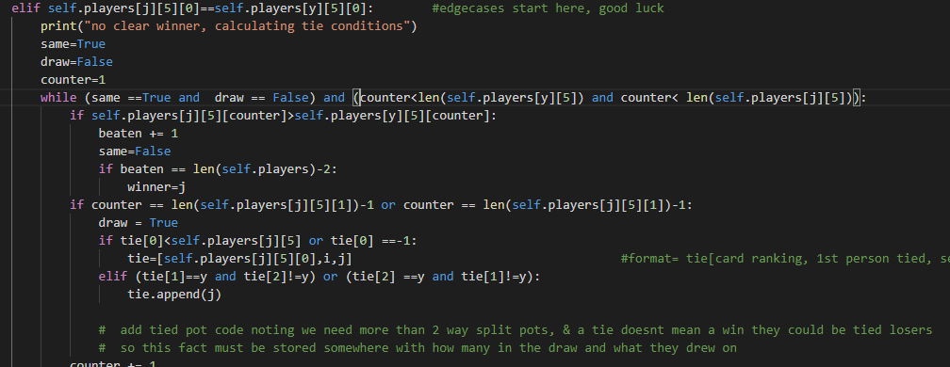
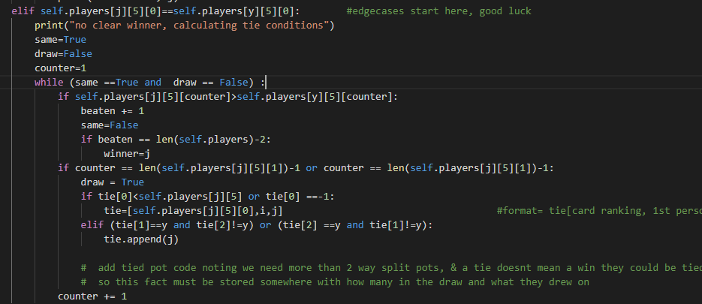
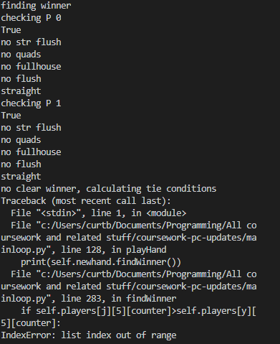
Dev screenshots error 1

Slide 19
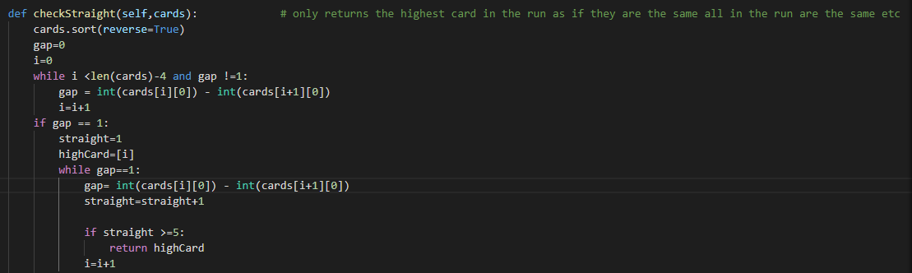

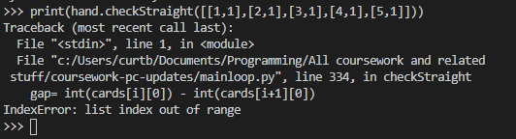
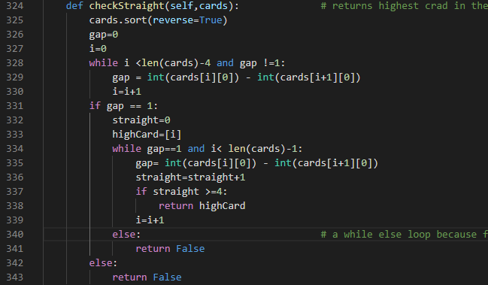
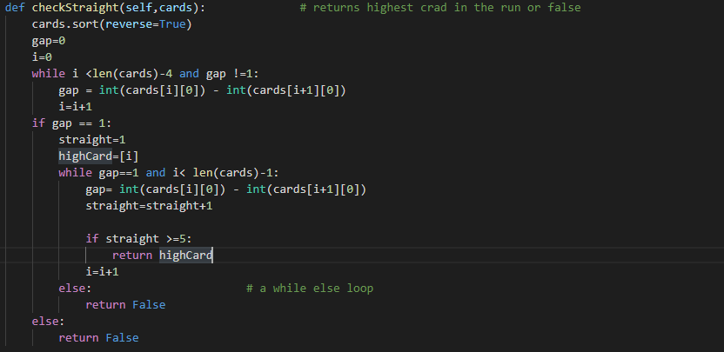
Check Straight function iterative testing

Slide 20
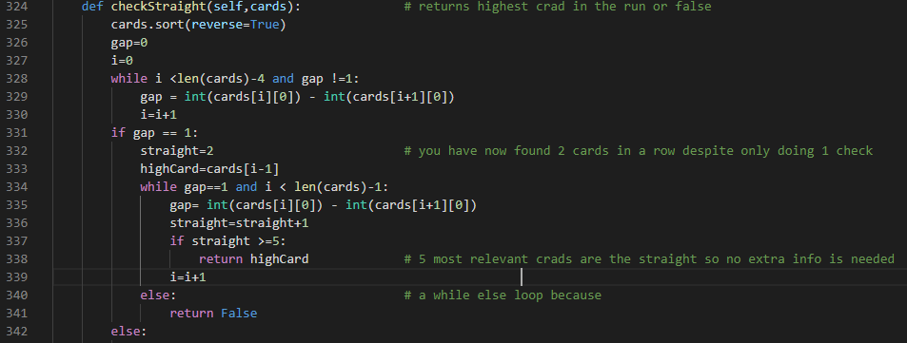
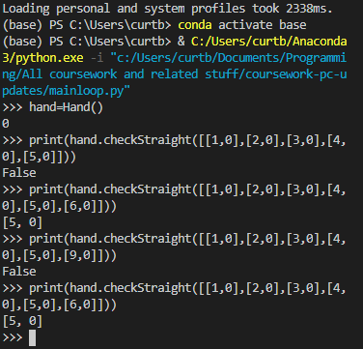
More check straight testing

Slide 21
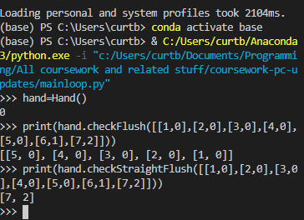

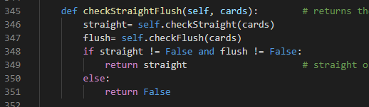
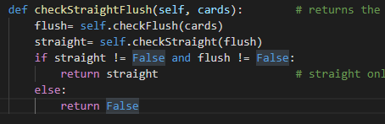
Check straight flush issue,

Slide 22
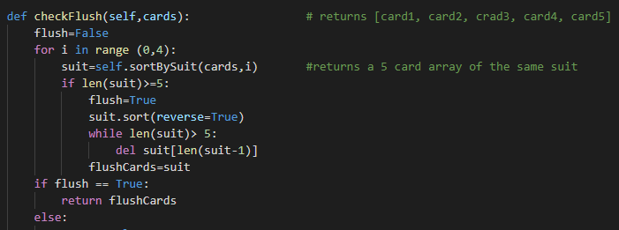
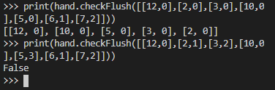
Check flush test + code

Slide 23
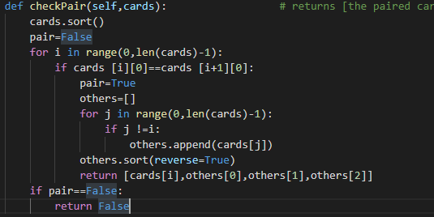
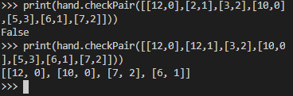
Check pair testing + code

Slide 24
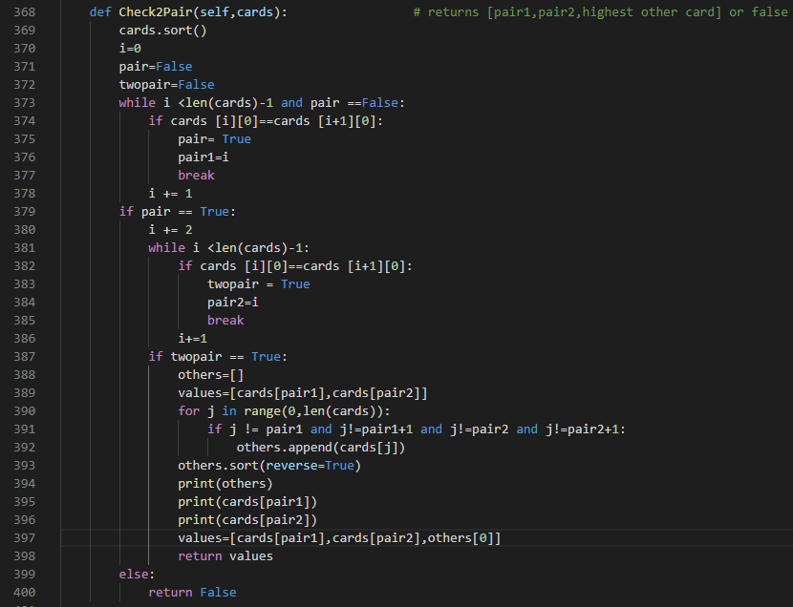
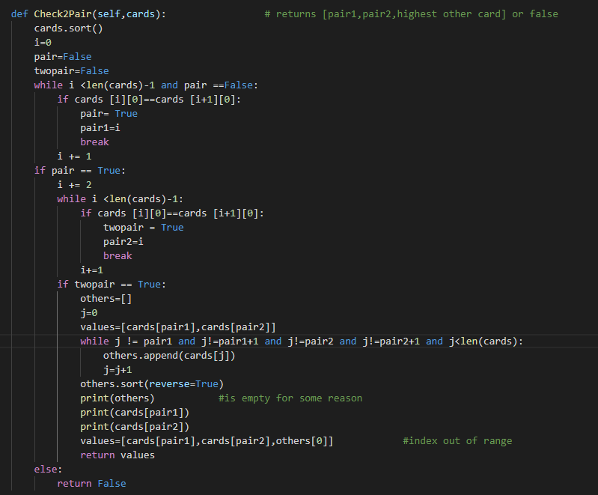
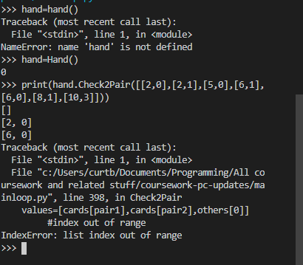
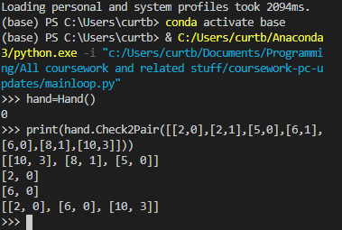
Check 2 pair test/ fix

Slide 25
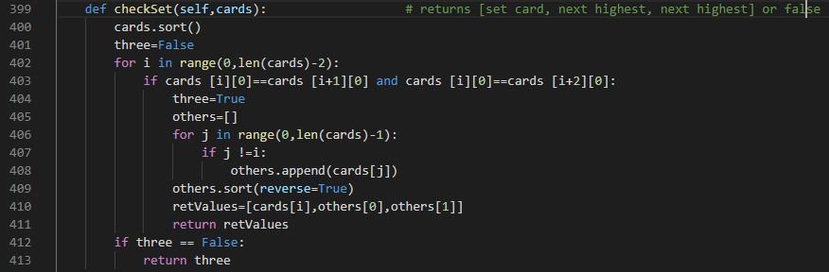


Check set test

Slide 26
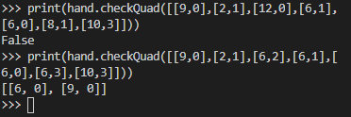
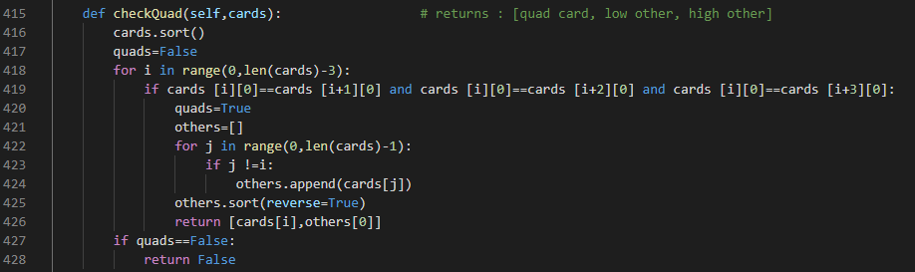
Check quad test

Slide 27
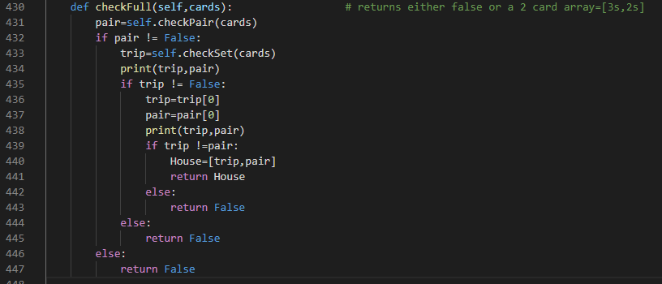
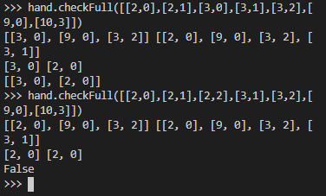
Check full testing before fix

Slide 28
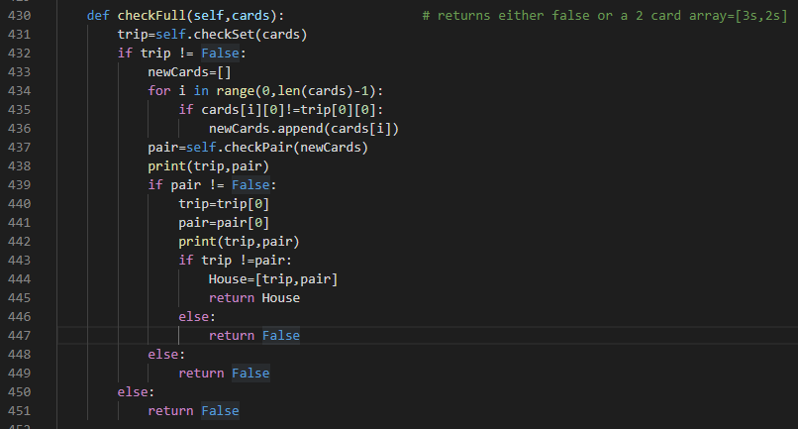
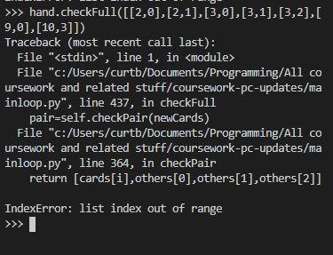
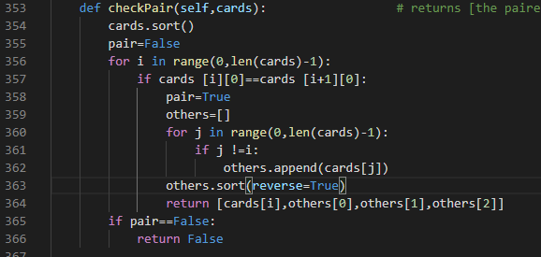
Check full first fix attempt

Slide 29
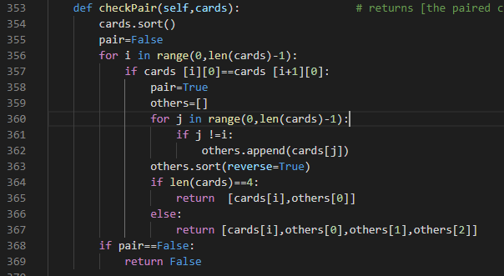
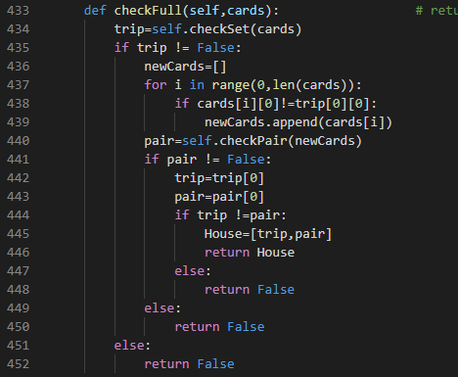
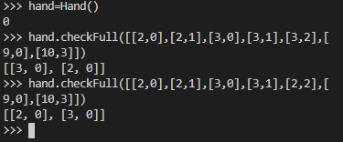
Check full, full fix

Slide 30
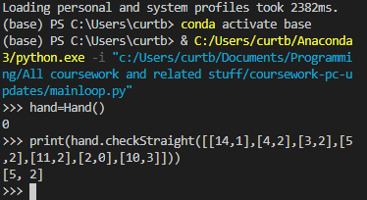
Making aces work
The next problem to deal with before refactoring and polishing the main loop and check winners code was making aces function as both high and low but not simultaneously, I made aces high in the database and added a check for an ace low straight in the check straight function, this could cause confusion while iterative testing takes place but once there is a ui it will be fine as I can assign it a picture of an ace
It was easier just to have a preset layout of what an ace low straight looks like than any other solution as this completely rules out any wrap around straight potential

Slide 31
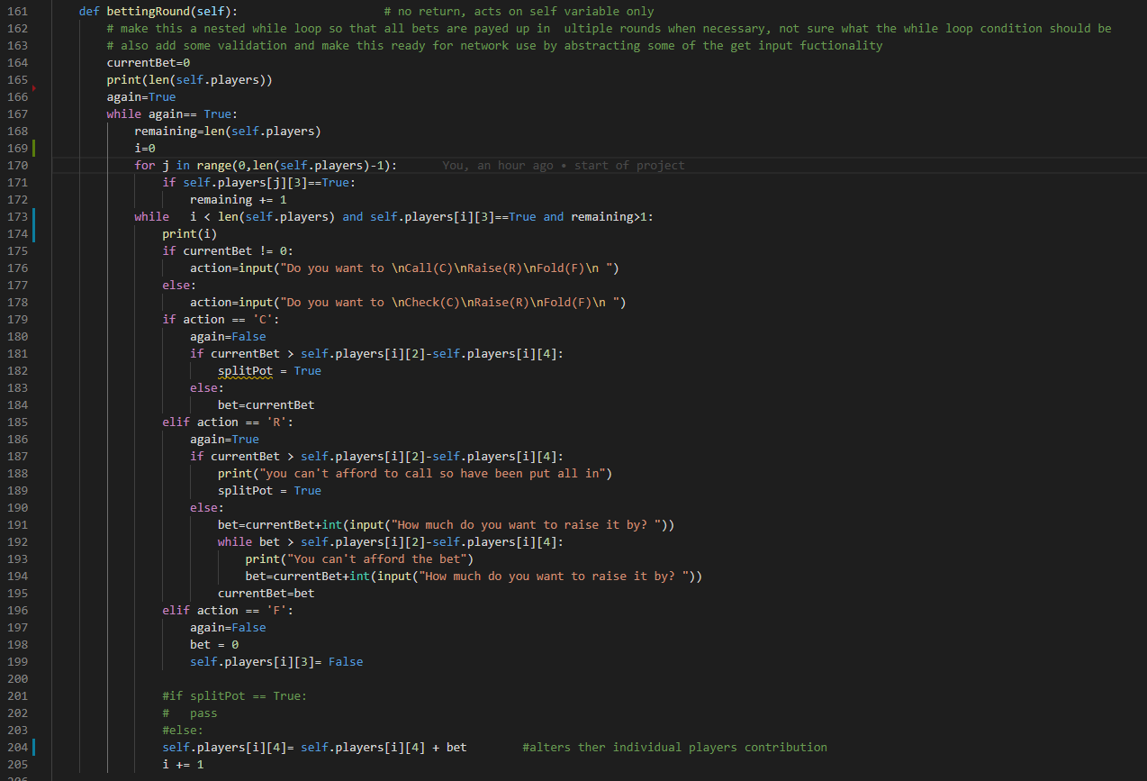
Making it so raises start another round properly attempt 1
This caused a problem that meant if you started another round because of a raise it would start a whole new loop of everyone meaning the original raiser is forced to have another action when they should not be able to. This needs fixing, this was an improvement on no solution at all but an extra condition where i != raiser for the while loop

Slide 32
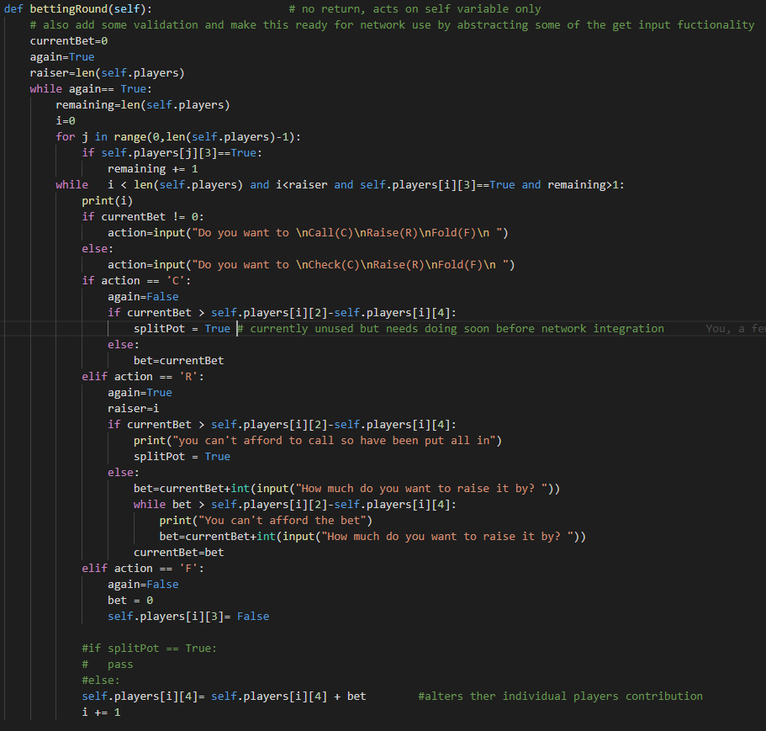
Making it so raises start another round properly attempt 1
This time I added a raiser variable set on the latest raises and I must be less than this as well as player length which removes the unintended double action bug that used to happen. This caused some issues as I needed to declare raiser before the while loop and the for loop and I needed a value, I chose to put it at the start of the function and gave it value of the length of the players dictionary so it would not change any behaviour until it is declared properly.

Slide 33
Making the code work with split pots
To make split pots function with the method I have devised I now need to have the findwinner function return an ordered list of who won and how much they contriputed

